Slide 1
Holy Comforter Church
Atlanta
Reflections on mental illness and life in community with God’s beloved world

Slide 2
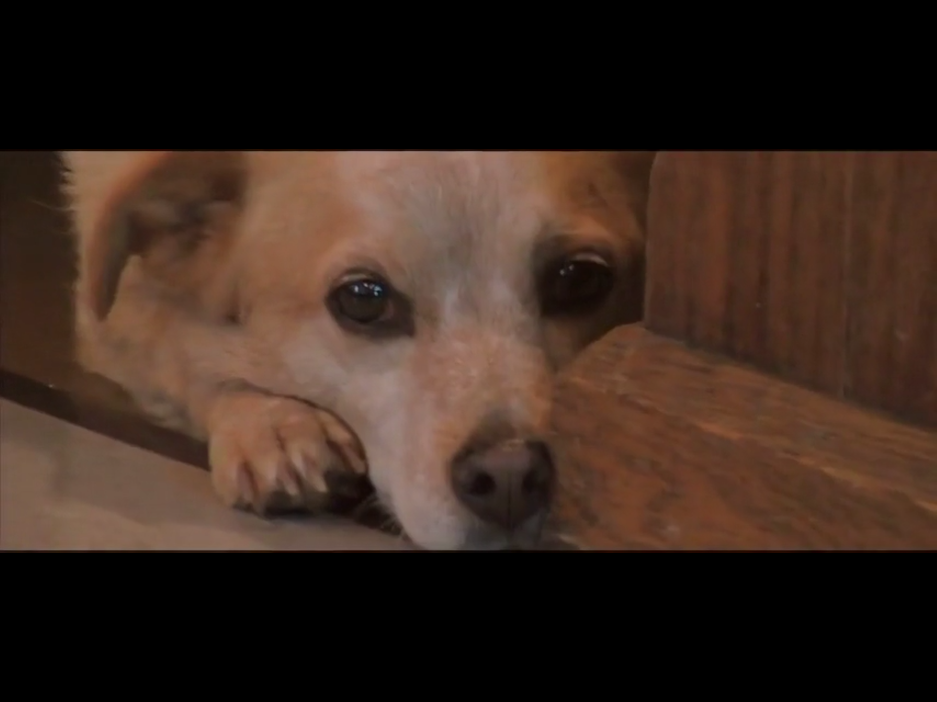
A video vignette
Videographer: Daniel W. Tanner
Ctrl + Click on Photo for Video

Slide 3
A brief history
1893: Founded in heart of Atlanta near textile mills
Mid-1980’s – After decades of struggle (Great Depression, World Wars, racial unrest, white flight, racial integration, internal issues), almost decommissioned
  Priest on Bishop’s staff pleads for one more chance and becomes vicar
  Walks streets inviting all who would come
  Most who come have been discharged from mental hospitals and live in marginal group homes
  Enough come that Bishop keeps HC as parish with ministry to people with mental illness
1996: Atlanta Olympics and temporary Friendship Centers
1997: Friendship Center at HC made permanent ministry

Slide 4
My history with Holy Comforter
2003: placement for vocational discernment and then seminary field work
2006-2014: Vicar of Holy Comforter and Director of the Friendship Center
My first question as Vicar: “Why should anyone support HC? What does HC do?”
  My answer: “HC offers community to people who often can’t find community.”
My next question: “Why aren’t people with mental illness more visible in our churches? Why do people with mental illness pass by so many other churches to come to Holy Comforter?”
  Research question for my Doctor of Ministry work: “What makes churches feel safe and welcoming to people with mental illness?”
  Research Method:
    Interview12 members of HC/FC community, all with lived experience of mental illness and of churches
    Qualitative analysis of transcripts
    Final paper reported how interviews and analysis informed my question and offered theological reflections on key points
    Title: Mental Illness & Belonging: A Pastor’s Inquiry

Slide 5
What Holy Comforter taught me
Feeling belonging subsumes feeling safe and welcome.
Feeling belonging depends on presence of certain key experiences:
  Participation: Am I invited and empowered to participate fully in the life and work of the community?
  Regard: Does the community accept and value my participation or merely tolerate it?
  Understanding: Is the community open to understanding me and my mental illness, or does is yield to the stigma of mental illness?
These experiences form layered supports for a robust sense of belonging.
  Belonging rests on participation.
  The value of participation rests on the community’s positive regard for that participation.
  That positive regard rests on understanding of mental illness and of people affected by mental illness.
  “Love is a wholehearted ‘yes’ to belonging.” Bro. David Steindl-Rast

Slide 6
Stigma & the Bible
Bible attributes mental illness to divine activity or evil spirits: punishment or possession and thereby contributes to stigma.
Dilemma for people of the Book:
  Keep the Book and participate in stigmatizing people with mental illness, or
  Toss the Book and lose the roots of our faith.
Is there another option? Yes. Dig deeper!
  King Saul’s “madness”: “Evil spirit from God” – but not marginalized. Text from a “cognitive context” in which all events were attributed to divine activity without attention to intermediate factors.
  Attend to countervailing texts: e.g., Leviticus excludes people with various impairments from priesthood, but also enjoins loving neighbor as self and not putting stumbling blocks before the blind.
  God’s “preferential option” for the poor, the abandoned, and the stigmatized.
  Attend to the cross: Whatever our interpretive strategy, God joins us in our insane, impaired, and abandoned flesh.

Slide 7
Conclusion
Specialized churches for people with mental illness is not the answer; inclusion in every church is.
Steps toward that goal:
  Pray for the “will to embrace.”
  Educate clergy, leaders, and members about mental illness.
  Engage: Sit and listen to another’s experience of mental illness.
  Regard people for who they are and whose they are, not for their illness.
    Recognize that mental illness may require accommodations that vary person to person.
  Invite and encourage participation to fullest extent of each person’s capacity.
    Focus on gifts and abilities, not on limitations.
  Get ready for church to become an experience that shatters and surpasses your expectations.
    Accept the church God gives you, not the one you thought you wanted.
“Man’s relation to man and man’s relation to God are one relation.”
Howard Thurman

Slide 8
Mental Illness, Society, & the Church
Writings by Mike Tanner
King Saul & the Stigma of Madness
Mental Illness & Violence
Mental Illness & Belonging: A Pastor’s Inquiry
Stories of Holy Comforter
Available at
https://belonging.today/essays-on-mental-illness-society-the-church/

Slide 9
Videos about Holy Comforter & its people
Partnership: Holy Comforter & Mercer University Center for Study of Narrative
  Introduction: https://www.youtube.com/watch?v=pB6orSgFZLo&feature=youtu.be
  Friendship Center: https://www.youtube.com/watch?v=n_Tj8YteoAg&sns=em
  Individual stories:
    Bob: https://www.youtube.com/watch?v=dnJs4_NVi-8&feature=youtu.be
    Sytha: https://www.youtube.com/watch?v=u32BsoQiun0&feature=youtu.be
    Brenda: https://www.youtube.com/watch?v=RKMgilDJqXk
    Emily: https://www.youtube.com/watch?v=AKK_voqaAdo&feature=youtu.be
    Lorenzo: https://www.youtube.com/watch?v=VkpKIAV-2jI&feature=youtu.be
    Kathy: https://www.youtube.com/watch?v=DRTEA4Z_M2c&feature=youtu.be
Creating a Garden of Comfort: https://vimeo.com/49466999
Opening video: https://vimeo.com/271889738

